Slide 1


Broadcast Workflow
Jerry Foss
jeremy.foss@bcu.ac.uk

Slide 2
Workflow
Effective workflow
ensure that critical business processes can be tracked and optimised over time
auditing, logging
to seamlessly orchestrate the interactions between enterprise resources
storage
transcoding
network
etc
... and groups of people

Slide 3
Production to Delivery
PLANNING
up to the point of shooting
conventions and practices to be adopted at the start of the process
RUSHES MANAGEMENT
capture and handling of content, on location or in a studio
up to the point of rushes archive and management.
POST-PRODUCTION
from the ‘ingest’ of material into the edit
through to the completion of the master
DELIVERY
production of masters for delivery to broadcasters, clients or audiences
DPP technical and metadata standards for file-based delivery of completed programmes.

Slide 4


Sources, Technologies and Architectures
Contribution
Dedicated links
Satellite
IP -based: low-res, high -res
Production
Editing
Colour grading
Subtitles
Metadata
Metadata Input
Archiving
Asset Management
(Predelivery – EPG .. etc)
Delivery
Metadata
Other Sources
Archive
News Agencies
Stock footage
Internet
Security, Asset Management
Distribution
Terrestrial
Satellite
Cable
Web: Live & VOD
Mobile
Metadata
If not networked, then probably …
Tape
Disk
SSD
Mobile, handheld devices
Metadata
User Content

Slide 5
Typical Essences, Wrappers, Metadata, etc
ESSENCES - Audio, Video
MPEG-2
H.264 .. AVC-Intra
Pro Res
SHQ / NDI
JPEG 2000
DNxHD (VC-3)
DNxRI (HR) (VC-3)
DVCAM
DVCPRO 25 / 50 … HD
AVI-DV
MPEG - 1
MPEG - 2 long GOP and I frame SD and HD
MPEG PS, TS
MPEG - 4
AES3
(S302M, S331M PCM, Dolby-E)
AIFF
Wave / BWF
AAC
METADATA
Structural Metadata SMPTE 377M
MPEG-7
EBU-Core
Descriptive Metadata Scheme - 1 (S380M)
Custom Metadata Scheme Via XML
AS11 1.1/DPP
SMPTE 434 dictionaries
WRAPPERS
AS11 1.1 / DPP
XAVC
Cinema DNG
AVC-Ultra
AVC-LonGOP (RDD 26:2014)
AVC Proxy (RDD 25:2014)
IMF
MXF …
OPAtom and OP1a
OP1b; OP1C; Op2a-c; OP3a-c
Codecs –
Acquisition
Mezzanine
Distribution

Slide 6
Workflow – From Traditional to Next Gen TV
Recent Developments in the Media Industry (and specifically TV)
Main technologues
UHD / 4K … 8K
HDR
video compression
storage
bandwidth
New services
Digital Media / Multi Platform
Multi-screen
Interaction and personalisation
Multi-sourced inputs in real time
Multiple potential outcomes of programme
Ingest of social media for playout
Requirement for information and metadata
... to describe all constituent actors and objects in the programme
... their position and movement
... their relevance to the end user
... integration of content with other events and media
... Advertising and placement integrated in to the content
... 360º video
... VR / TV
... assisted TV, accessibility

Slide 7
Contribution and
Distribution

Slide 8
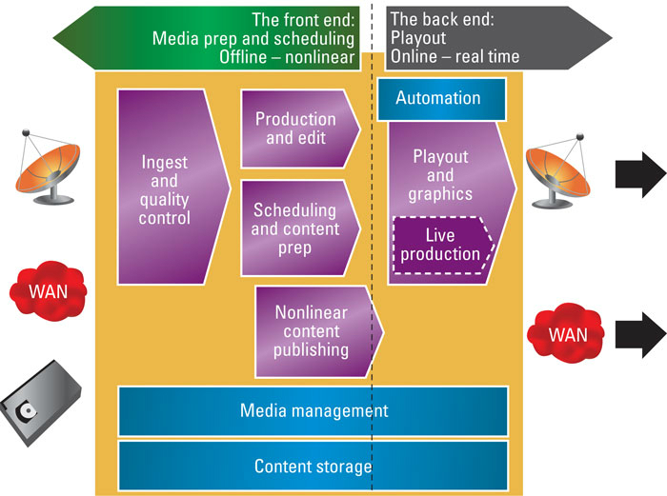
Contribution and Distribution

Slide 9
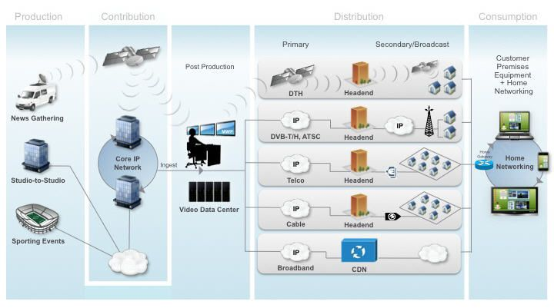
Contribution and Distribution
Production Contribution Distribution Consumption
http://www.cisco.com/c/en/us/solutions/service-provider/distribution/index.html#

Slide 10
Contribution and Distribution
Contribution (distinct from Distribution) - Transport of media content
- video, audio, metadata, and ancillary data - between professional users
ingest
capture and production activities
Key aspects for contribution
Picture quality
Latency
prime importance for contribution
end to end delay - encoding and decoding process
less important for distribution
distribution emphasis: maximizing picture within the available bit rate
Synchronisation →
Encryption →
http://cable.doit.wisc.edu/SMPTE/01-Compression%20for%20IPTV/Trow.TP.01-14-2008.pdf

Slide 11
Contribution Quality
Synchronisation
close audio / video sync needed in production environment
tolerances -
-5 to +15ms = “lip-sync”
relaxed in contribution applications ~ -5 to +30ms)
c.f. Distribution applications
tolerances significantly relaxed
lip-sync acceptable -40 to +60ms limits
Encryption
contribution
- limited number of encryption standards
distribution
- wide array of encryption and entitlement schemes being commonly used

Slide 12
Contribution Quality
According to DVB Commercial Module:
Quantified as equivalent to uncompressed or very mildly compressed source material
assumed that the material is full frame rate
usually 4:2:2 chroma-subsampling sampling
Compare to:
Broadcast Quality
equivalent to Satellite, Terrestrial and Cable broadcast
full frame rate but at a quality not assumed appropriate for contribution applications
Good Quality
commercially acceptable quality
not considered acceptable for contribution except as a last resort
or for fast response news applications
not necessarily full frame rate
Acceptable Quality
commercially acceptable for low data rate applications
Mobile Phone Quality
equivalent to CIF and QCIF resolutions (phones, etc)
(but more HD phones now)
CIF - Common Intermediate Format - resolution of 352 × 288
QCIF - Quarter CIF

Slide 13


Broadcast and Production Workflow (BBC Schematic)
Transmission
Low end /
Domestic
Camcorders /
DSLRs
Edit
PRODUCTION
Effects
Grading
CODING
&
MULTIPLEX
Audio
Dubbing
News
Camcorders
Graphics
SCHEDULE
CREATION
Hi-End
Camcorders
Data
Input
AUTOMATION
& PLAYOUT
EPG
CREATION
Digital
Cinema
Cameras +
Recorders
ACQUISITION
LOGGING
INGEST
MEDIA
STORE
DELIVERY
Multi-
Camera
Studio / OB
Data Store
Database
Streaming
Encoding
Live Feeds
Studios
OBs
Other
Material
iPlayer
Website
Data
Input
CDN
INTERNET
ARCHIVE
Media
Metadata
Both

Slide 14
Broadcast and Production Workflow (BBC Schematic)
Implementation ...
“IP Studio”, maybe ...
… from SDI / Traditional Workflow Suites
… to Commodity COTS
NMOS ( FIMS ?)
??? ROI, Integration, Interoperability,
Flexibility, Scale Investment, future proof, standards, skills ..
Transmission
Low end /
Domestic
Camcorders /
DSLRs
Edit
PRODUCTION
Effects
Grading
CODING
&
MULTIPLEX
Audio
Dubbing
News
Camcorders
Graphics
SCHEDULE
CREATION
Hi-End
Camcorders
Data
Input
AUTOMATION
& PLAYOUT
EPG
CREATION
Digital
Cinema
Cameras +
Recorders
ACQUISITION
LOGGING
INGEST
MEDIA
STORE
DELIVERY
Multi-
Camera
Studio / OB
Data Store
Database
Streaming
Encoding
Live Feeds
Studios
OBs
Other
Material
iPlayer
Website
Data
Input
CDN
INTERNET
ARCHIVE
Media
Metadata
Both

Slide 15
Overview of
many / some of
Workflow Processes

Slide 16
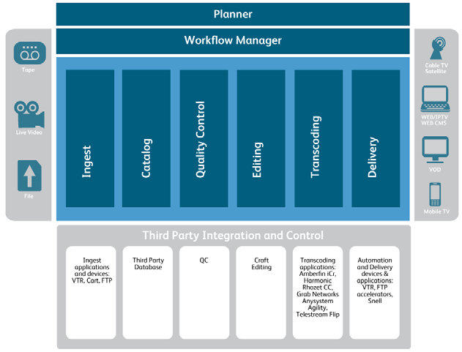
Workflow Processes
Typical – there are many variations ...
... and automated:
http://www.snellgroup.com/documents/brochures/automation-and-media-management/Momentum.pdf

Slide 17
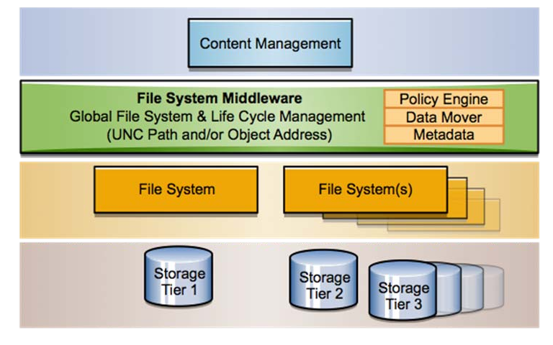
MEDIA ASSET MANAGEMENT
Database
BPM: Business Process Management (“Workflow Engine”)

Slide 18

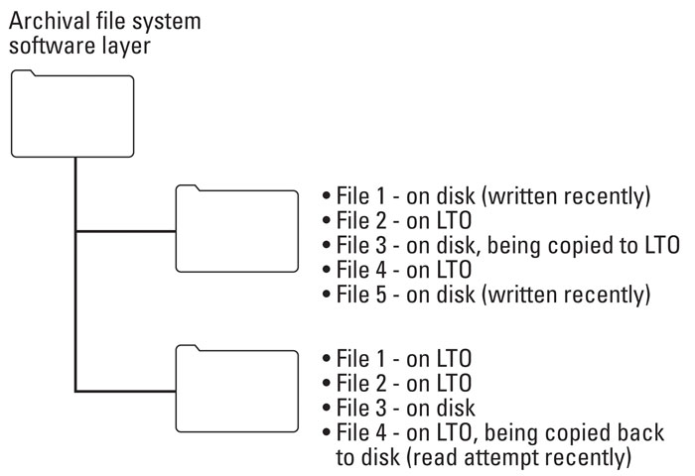
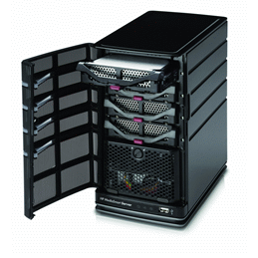

Typical MAM File System Approach
Preferred approach - file-folder structure
accessible via a standard network protocol (rather than a proprietary interface between the storage and the asset management system)
File 1: DISK H1 … written today
File 2: LTO L3
File 3: DISK H4 … being copied to LTO L2
File 4: LTO L2
File 5: DISK H3 … written last hour
File 1: LTO L7
File 2: LTO L5
File 3: DISK H2
File 4: LTO L1 being copied back to disk (due to recent read attempt)
+ access to other cloud storages (own, third party)

Slide 19
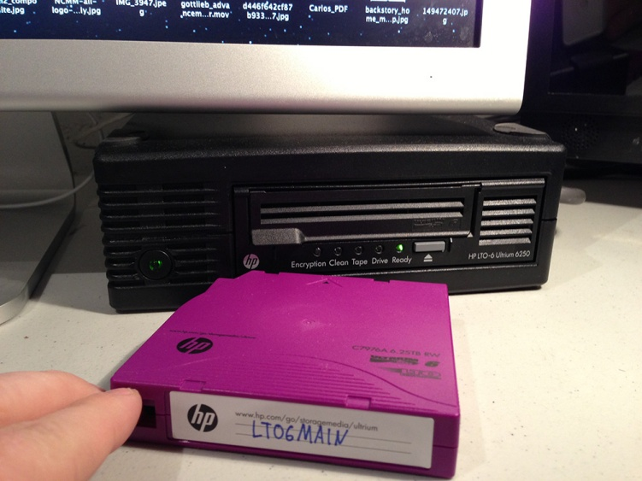
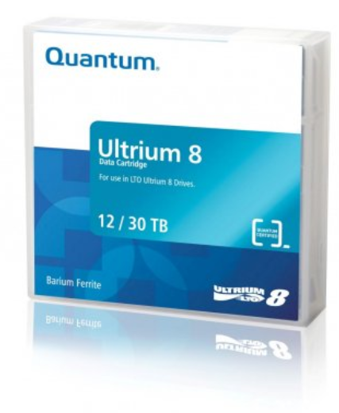
Linear Tape Open – to LTO 10
General specifications
Tape type | Raw capacity (compressed capacity @ 2.5:1) | Max Uncompressed Speed MB/s (note bytes) | WORM | Released
LTO-1 | 100 GB | 20 | No | 2000
LTO-2 | 200 GB | 40 | No | 2003
LTO-3 | 400 GB | 80 | Yes | 2005
LTO-4 | 800 GB | 120 | Yes | 2007
LTO-5 | 1.5 TB | 140 | Yes | 2010
LTO-6 | 2.5 TB 6.25 TB | 160 | Yes | 2012
LTO-7 | 6.4 TB 16 TB | 315 | Yes | 2015
LTO-8 | 12.0 TB 30 TB | 472 (upto 900Mb/s) | Yes | Now
LTO-9 | 26 TB 65.2 TB | 708 | Planned | TBA
LTO-10 | 48 TB 120 TB | 1100 | Planned | TBA
(2014 … )
Sony Tape @ 148Gb/in2
… 185TB per cartridge
Note comparative native / compressed capacities

Slide 20
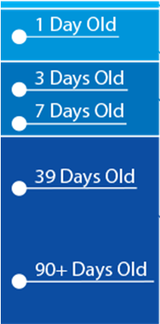
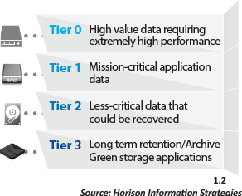
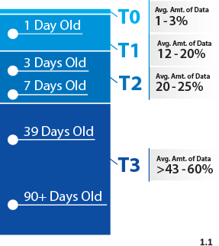



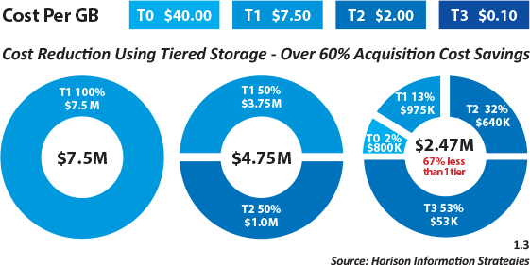
Tiered Archival Storage
(i.e. sustainable)
The Economics of Tiered Archival Storage
Tiered storage utilizing tape
reducing power
cooling
space
media and administration costs
efficient access via LTFS indexing
infrastructure cost reduction
http://perpetualstorage.com/need-right-data-right-place/ [as at 2013]

Slide 21
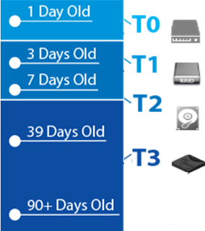
Cloud Archival
Storage of an organization’s
media assets:
original content
EDLs
finished masters
copies
versions
releases, etc
ingest and content collection
playout from the cloud
processing in a virtual environment
Cloud-based storage being used for
.. so what is the need (and issues) for storage in the cloud ?
Cloud concerns
storage alternatives
tier-based migration
automated management
Storage alternatives
Backup or archive
On-prem or in co-lo
Private, hybrid or public cloud

Slide 22
MXF – Material eXchange Format
wrapper
interchange of finished / almost finished audiovisual material
+ metadata
AAF – Advanced Authoring Format
wrapper – essence + metadata
post-production stages

Slide 23
Advanced Authoring Format (AAF)
digital nonlinear post production and authoring
“Super-EDL”
supports essence + associated metadata
provide cross-platform interchange
of metadata or program content
track history of program content
from source elements through final production
content to be described as a media object

Slide 24
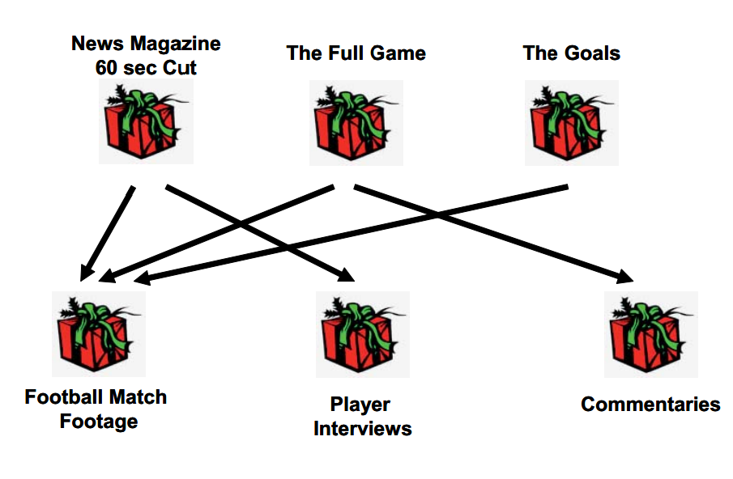
MXF – Material eXchange Format
Material Packages
desired output timeline
File Packages
represent the
source material
e.g. clip composed from a pair of recordings
MXF file has -
2 File Packages and
1 Material Package (instructs decoder how to play the packages)

Slide 25
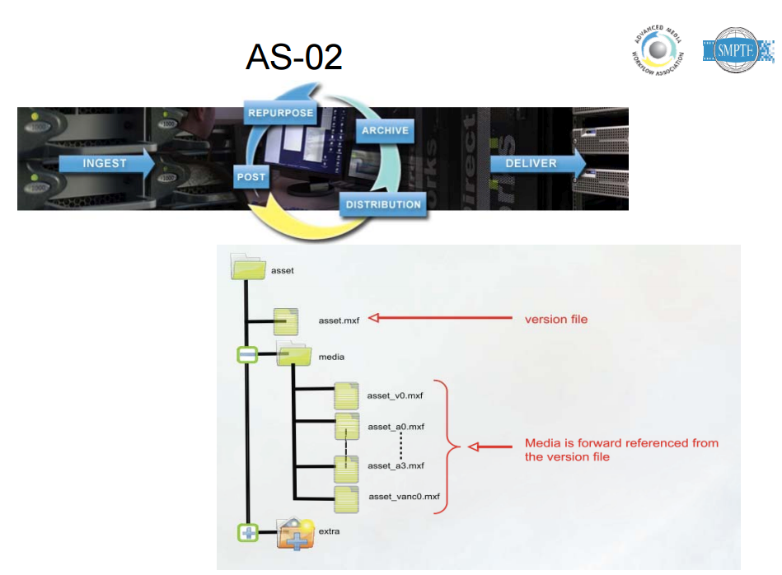

VERSIONING
AS-02 – typically in TV broadcast

Slide 26
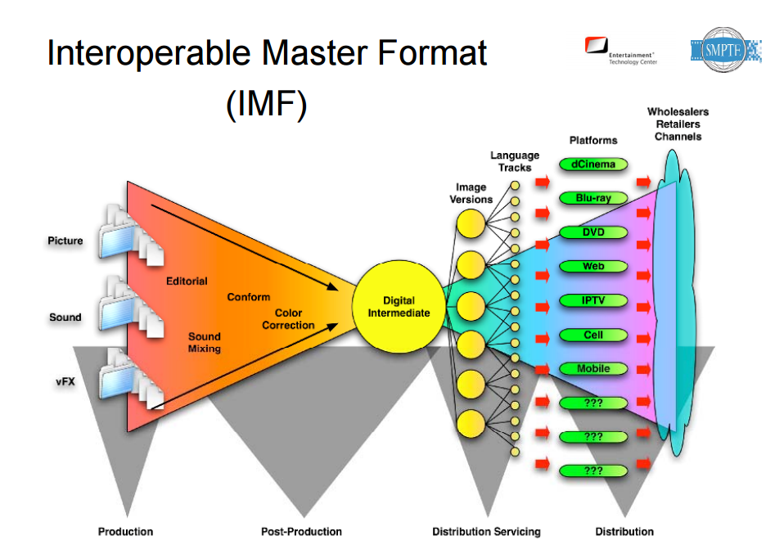
Versioning - IMF
IMF - Interoperable Master Format
High Quality Multi Version Masters for Studio Applications
Typically in the Film Industry

Slide 27
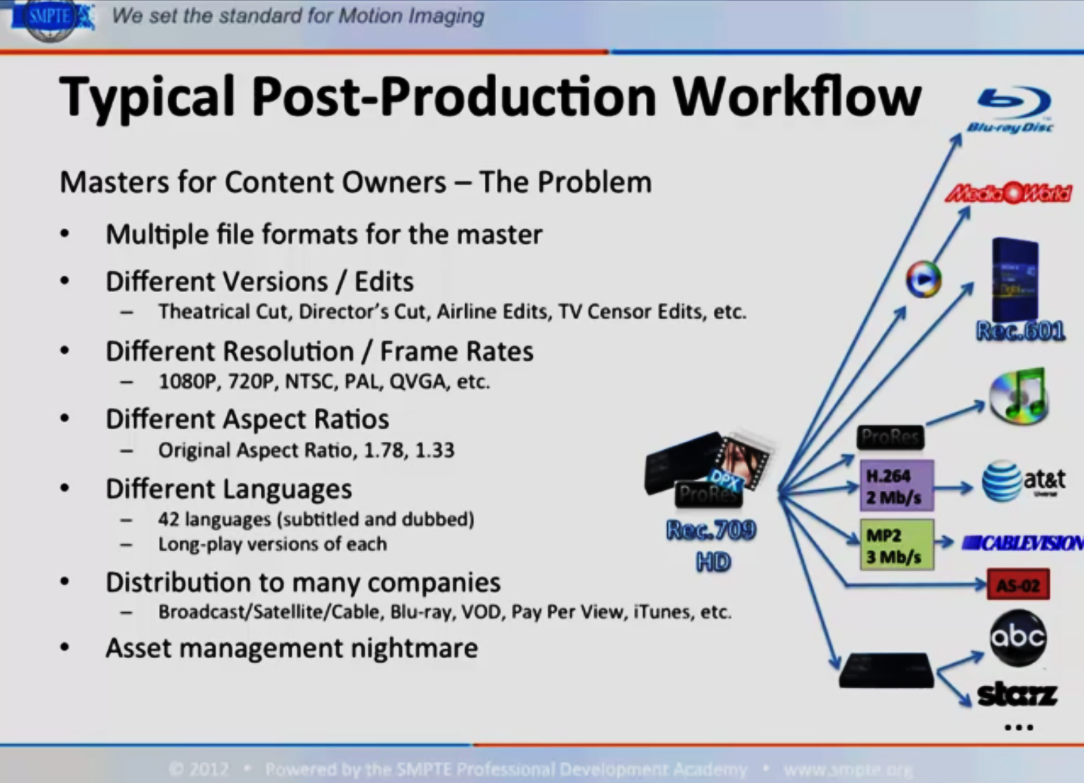
IMF - Interoperable Master Format
https://www.smpte.org/PDA_On-demand/IMF (1h 09m)

Slide 28
IP Workflows
SMPTE 2022, 2110

Slide 29
IP Workflows
Why IP is replacing SDI*
Universal connectivity (broadcast and other industries)
Lower budgets, higher quality requirements
Production companies scaling:
IP allows best production talent remains in a central location
Receive camera feeds from remote locations
Democratise the industry
single producer can have many camera inputs from anywhere in the world
* although SDI is still in development

Slide 30
How is IP Television Routing Different from SDI ?
In SDI Routing, all routing in the SDI crosspoint frame
The Control System tells the crosspointwhat to switch where
The Crosspoint Router switches everything internally
Receivers just receive all data sent to them
In IP Routing, the Receiver is involved …
Control System tells the Receiver:
What Multicast Group & Port# to switch to (Main and Protect)
Technical Metadata of the new stream
The Receiver is responsible for how it switches/transitions to it
The Receiver asks the network for the new signal
The network provides the new signal through packet forwarding logic
https://www.smpte.org/sites/default/files/section-files/GVExpo2018%20SMPTE%2004%20-%20Scalable%20Facilities%20with%20ST%202110%20-%20Mailhot.pdf

Slide 31
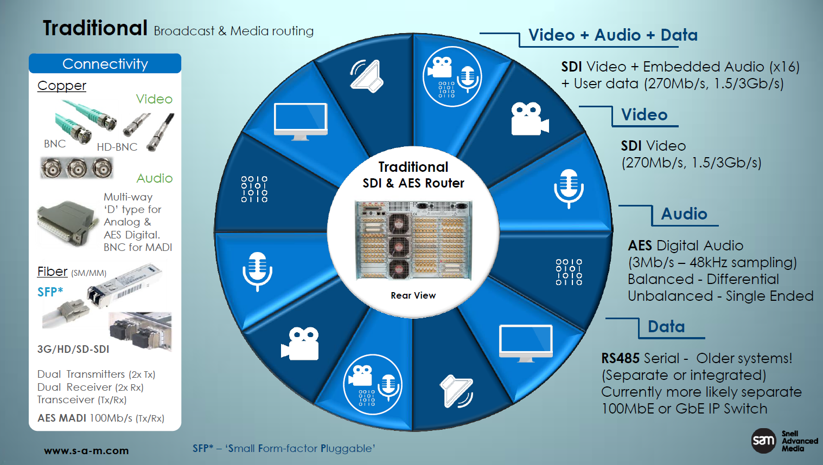

Traditional Broadcast and Media Routing
Slide from Phil Myers, Snell Advanced Media, SMPTE presentation, BCU. 2017

Slide 32
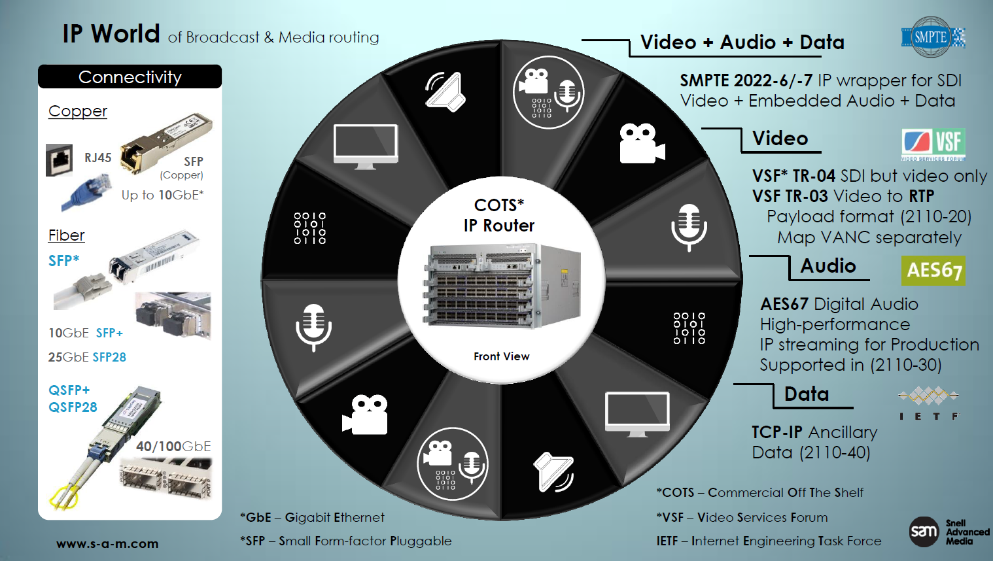
IP World of Broadcast and Media Routing
Slide from Phil Myers, Snell Advanced Media, SMPTE presentation, BCU. 2017

Slide 33
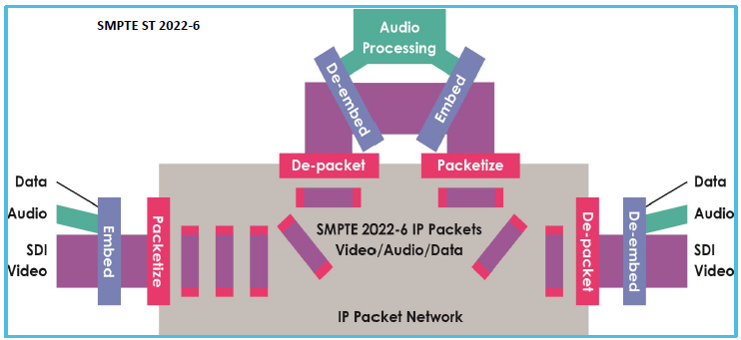
SMPTE ST 2022-6 (Multiplexed Streams)
Slide from Phil Myers, Snell Advanced Media, SMPTE presentation, BCU. 2017

Slide 34
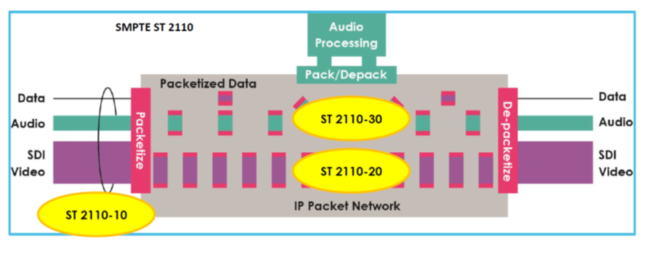
SMPTE ST 2110 – Essence Streams
Slide from Phil Myers, Snell Advanced Media, SMPTE presentation, BCU. 2017

Slide 35
Workflow
.. next …

Slide 36
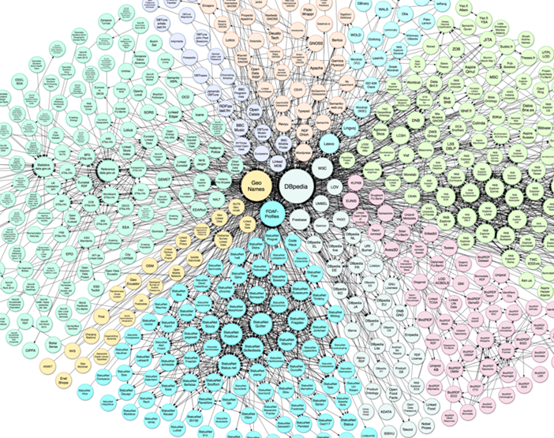
Metadata …
Semantics and Workflow

Slide 37
Service Based Workflow - SOA / FIMS / Microservices
Having split workflow into services …
Can outsource it and grow utilisation of third part sevices
… into the cloud ..
Could be another operational model for MXF?
Broadcaster flexibility in whether / or not to invest in infrastructure
Microservices
MJDrouin, VSF

Slide 38
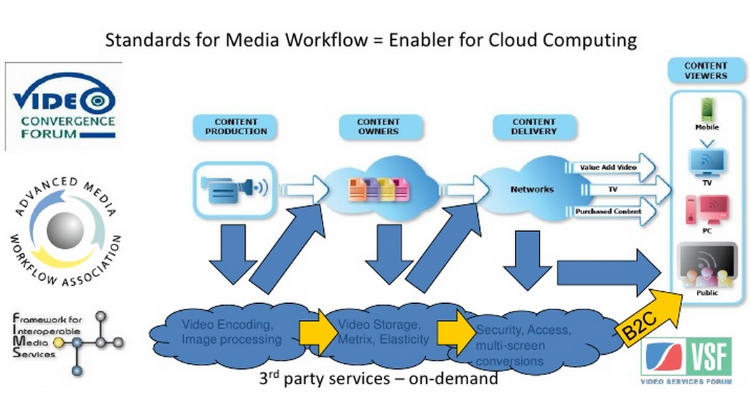
Service Based Workflow ... cloud based
MJDrouin, VSF

Slide 39
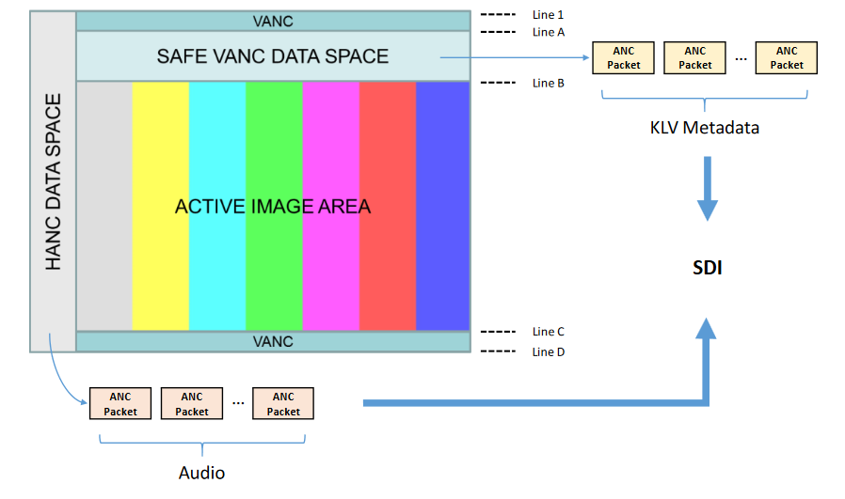
SMPTE ST 2022-6 - IP Packetisation of SDI Raster
Bundled (Audio, Video, Metadata together)
Audio/Video/Metadata/Sync travel coherently
Requires extra work to “unpack” separate essences
One IP Address
Video
+ Audio
+ Metadata

Slide 40



ST 2110 – Essence-Based Approach
Essence Based (Audio, Video, Metadata separate)
Suited for Studio/Production workflows
Individual essence kept in sync using PTP timing
No blanking!
IP Packetisation of Active Video
IP Address #1
Video
IETF RFC 4175
IP Packetisation of Audio Channels
AES-67
IP Address #2
Audio
IP Packetisation of ANC Data
IETF ANC291
IP Address #3
Metadata

Slide 41
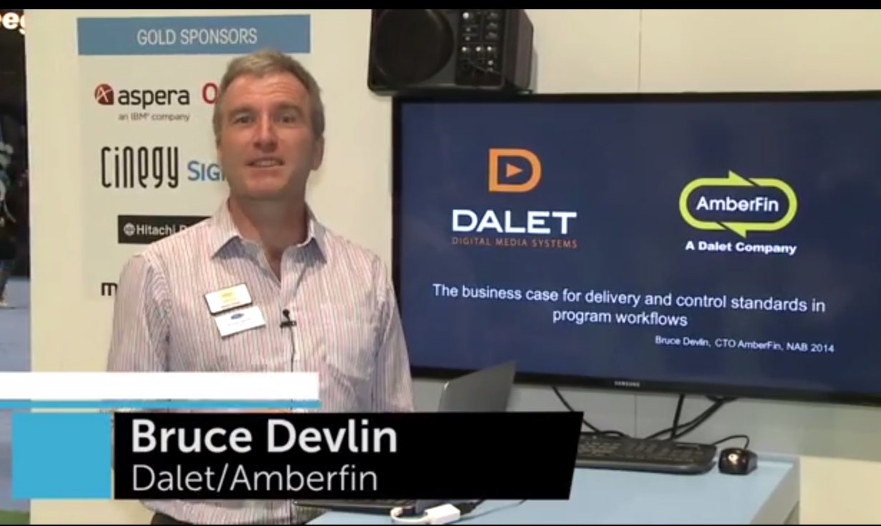
The business case for delivery and control standards in program workflows - Bruce Devlin, 2014
A historical perspective leading to Digital Delivery, but a highly relevant argument of various interoperable developments across the industry
https://youtu.be/K3dn5gQYyw4
(at 11m15 there’s a section on FIMS: FIMS is becoming less relevant, but the underlying issue is still important – note my comments in class)

